Slide 1
Predicting MPG
From fuel bills to a four-variable equation to the 2045 fleet
weight · horsepower · hybrid · electric — R² = 0.955
OS 3810 Probability & Statistics — Final Project
EPA Model Year 2024 compliance data, N = 1,285 vehicles (gasoline, hybrid, and electric), plus the EPA fleet record 1975–2024
Notes:
Good afternoon. Our project asks a simple question with a fifty-year answer: can you predict how far a vehicle goes on a gallon of energy from a handful of numbers on its spec sheet? We will show that four numbers do it for gasoline, hybrid, and electric vehicles alike, and then use that equation as an instrument to read fifty years of fleet history and project the next twenty. The arc: what fuel costs households, what the data look like, which variables we chose and why, the regression and its tests, a normalization the equation makes possible, and what it says about 2045.

Slide 2
1 FUEL COSTS AND THE RESEARCH QUESTION
Fuel is a four-figure annual bill, and MPG sets it
$2,463
$1,007
$49,855
annual energy cost of the median gasoline vehicle (15,000 miles, 2024 prices)
the same year of driving in the median battery-electric vehicle
average price actually paid for a new vehicle, July 2026
MPG is the lever connecting vehicle design to what drivers spend.
Research question: which physical design variables predict a vehicle's fuel economy, how well, and what does that let us say about the fleet's future?
Sources: fueleconomy.gov catalog x BLS national energy prices; Kelley Blue Book / Cox Automotive average transaction price, July 2026. Full links on the Data Links slide.
Notes:
Let's start with money, because that is why anyone outside a lab cares about MPG. Take the median gasoline vehicle on sale in 2024, drive it a typical fifteen thousand miles at 2024 pump prices, and you burn about twenty-five hundred dollars. Do the same year of driving in the median battery-electric vehicle and the energy bill is about a thousand. The average new vehicle now sells for nearly fifty thousand dollars, so fuel is the second-largest recurring cost of owning it. Fuel economy is the single number that converts a vehicle's design into that bill. So our research question is: which physical design variables predict a vehicle's fuel economy, how well do they predict it, and what does having that equation let us say about where the fleet is going?
IF ASKED how the costs were computed: fueleconomy.gov catalog efficiency for every 2024 model, times the BLS national average price of regular gasoline and residential electricity for 2024, at 15,000 miles a year. Median vehicle in each powertrain group.

Slide 3
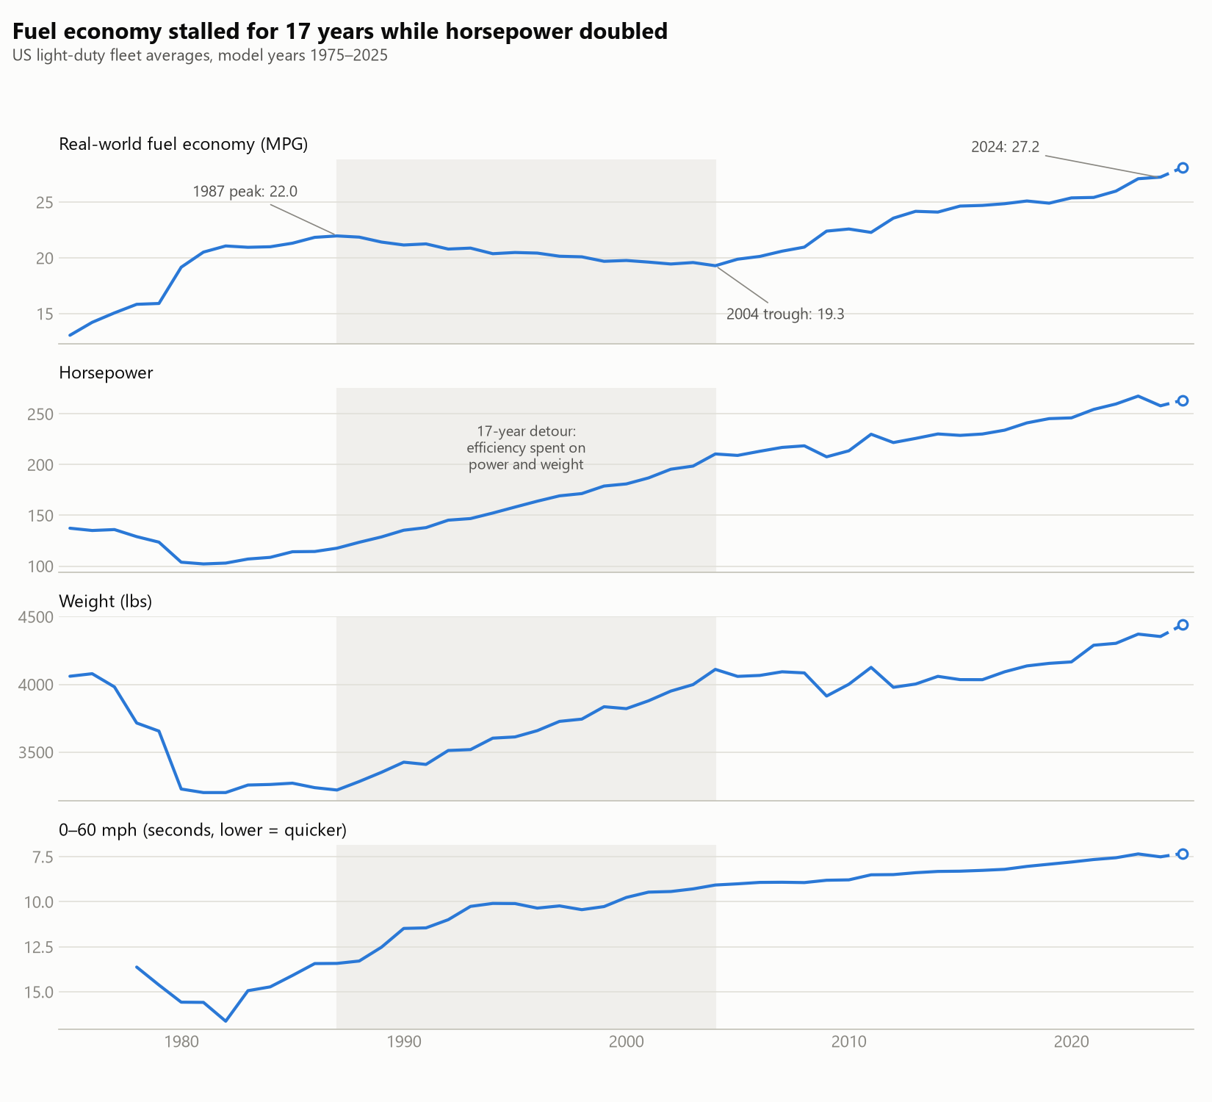
2 DATA UNDERSTANDING: CURRENT MPG TRENDS
Fifty years of fleet MPG: it rose, stalled for 17 years, then rose again
1975–1987: 13.1 → 22.0 MPG as CAFE standards arrive.
1987–2004: MPG slips 22.0 → 19.3 while the fleet gains ~900 lbs and ~90 HP. Weight bought safety (deaths per 100M miles fell from 3.35 to ~1.2); power bought acceleration (0–60 halved, 13.4 s → 7.5 s).
2004–2024: 19.3 → 27.2 MPG as standards tighten and hybrids and EVs enter.
Raw MPG mixes technology with what buyers and regulators asked the technology to carry. We will come back to this.
Source: EPA Automotive Trends Report, production-weighted fleet averages, model years 1975–2024 (2025 preliminary excluded). Fatality rate: BTS Table 2-17.
Notes:
Before we touch a regression, here is the fifty-year record we are trying to understand. This is the EPA's own fleet average, weighted by how many of each vehicle were actually built, from 1975 through 2024. Three acts. First, 1975 to 1987: fuel economy jumps from thirteen to twenty-two miles per gallon as the first CAFE standards bite. Second, 1987 to 2004: seventeen years where fuel economy actually slips, from twenty-two to just over nineteen. The fleet gained roughly nine hundred pounds and ninety horsepower in those years. That weight bought safety: deaths per hundred million miles fell from three point three five to about one point two. That power bought acceleration: the average zero-to-sixty time halved. Third, 2004 to today: back up to twenty-seven as standards tighten and hybrids and electrics arrive. The lesson we want you to hold onto is that raw MPG mixes the technology with what buyers and regulators asked that technology to carry. Our equation will let us separate the two.
IF ASKED whether this is the same data as the regression: no. This chart is the fleet-level series, one number per year for the whole industry. The regression uses a different EPA file, one row per 2024 model type. Both are on the data slide.

Slide 4
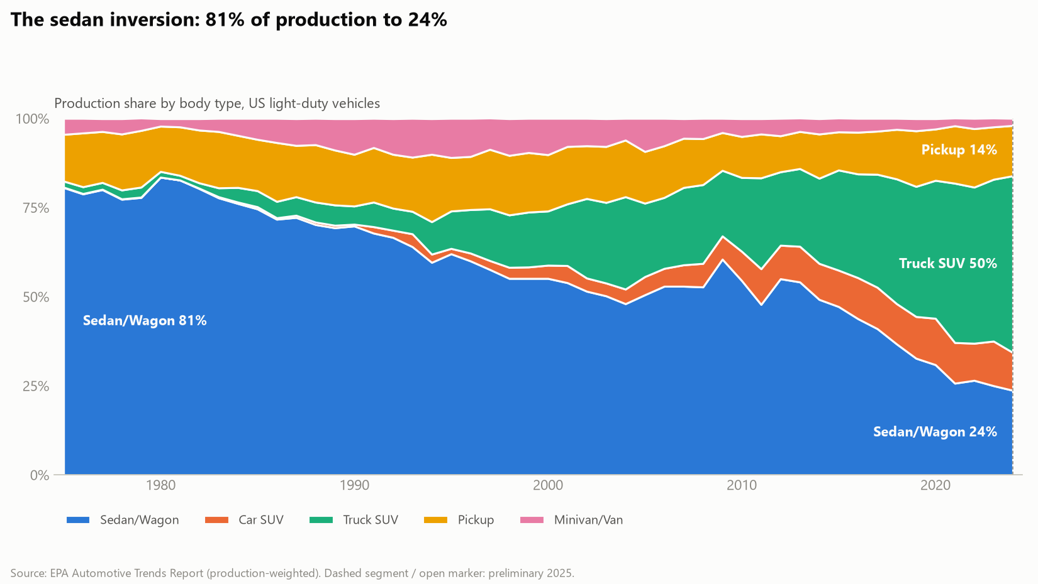
2 DATA UNDERSTANDING: DIFFERENT CLASSES OF CARS
The sales mix inverted: sedans fell from 81% of production to 24%
Trucks and SUVs now carry two-thirds of production: Truck SUV 50%, Pickup 14%, Car SUV and minivans the rest.
Why it matters for MPG: heavier, more powerful classes sit lower on every efficiency curve we will show. The fleet's fuel economy is the equation applied to whatever mix buyers choose.
Classes reappear later, each normalized to its own design, where they turn out to improve at nearly the same rate.
Source: EPA Automotive Trends Report, production share by vehicle type, 1975–2024.
Notes:
The second thing to understand about the data is who is buying what. In 1975, eighty-one percent of vehicles produced were sedans and wagons. Today it is twenty-four percent. Truck-type SUVs alone are half of production and pickups another fourteen. This matters for fuel economy because the heavier, more powerful classes sit lower on every efficiency curve we are about to show. The national fleet's MPG is really our equation applied to whatever mix of designs buyers choose. We will come back to classes near the end, where each one gets normalized to its own design, and they turn out to improve at almost the same pace.

Slide 5
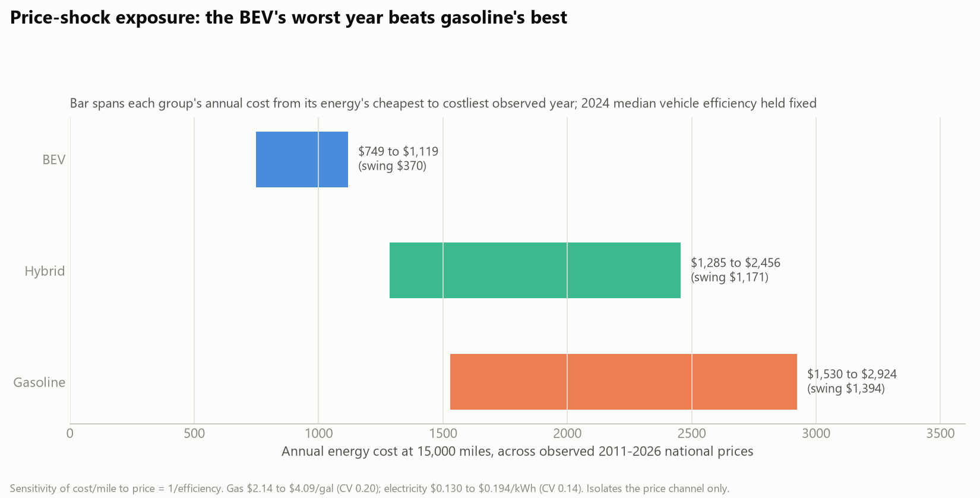
2 DATA UNDERSTANDING: WHAT MATTERS TO BUYERS
Why buyers care: MPG is a cash-flow forecast
4.5 years
energy savings alone repay the $6,477 EV purchase premium ($1,456 saved per year at 2024 prices)
Price-shock insurance: across every energy price observed 2011–2026, the gasoline driver's annual bill swings by $1,394; the BEV driver's by $370. The efficient vehicle is also the predictable one.
Sources: fueleconomy.gov catalog x BLS gasoline and electricity prices 2011–2026; KBB / Cox Automotive July 2026 transaction prices.
Notes:
Why does fuel economy matter to a buyer? Because it is a forecast of cash flow. Take the July 2026 average transaction prices: an electric vehicle carries about a sixty-five hundred dollar premium over the industry average. At 2024 energy prices the median EV saves roughly fourteen hundred and fifty dollars a year in energy, so the premium repays itself in about four and a half years on energy alone. The chart shows a second reason: volatility. Across every gasoline and electricity price we observed from 2011 to 2026, the gasoline driver's annual bill swings by about fourteen hundred dollars from cheapest year to dearest; the electric driver's swings by under four hundred. Higher efficiency is also more predictable spending. That is the consumer side of the equation we are about to build.
IF ASKED about maintenance, insurance, or depreciation: deliberately excluded. This is energy cost only, which is the part MPG controls.

Slide 6
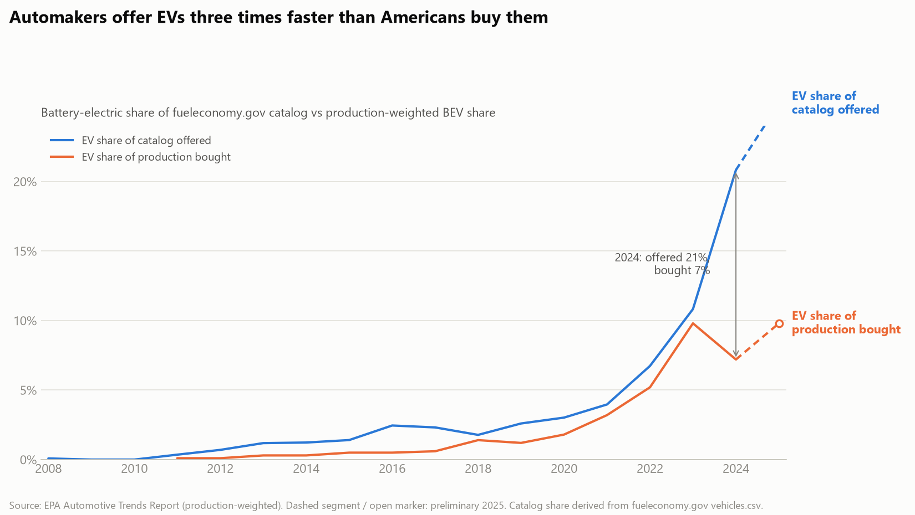
2 DATA UNDERSTANDING: EVS SPECIFICALLY
EVs: offered faster than bought, and sensitive to the tax credit
2010: first mass-market EVs delivered (Nissan Leaf, Chevrolet Volt)
2022: Inflation Reduction Act rewrites the $7,500 credit
2023: credit-driven surge; BEVs reach 35.7% of the Car SUV class (the Model Y)
2024: the hangover; sedan-class BEV share halves (14.6% → 7.1%)
The gap persists: 21% of the 2024 catalog is electric; 7.2% of production is. Adoption tracks incentives and the energy-cost advantage.
Sources: EPA Automotive Trends powertrain shares; fueleconomy.gov catalog; dated events from the project's cited timeline (external/events_timeline.csv).
Notes:
Electric vehicles get their own beat because they behave differently from the rest of the market. The chart compares what automakers offer with what Americans buy. Twenty-one percent of the 2024 catalog is electric; seven percent of production is. Manufacturers are offering electrics roughly three times faster than buyers are taking them. And adoption is visibly policy-sensitive. The first mass-market EVs arrived in 2010. The Inflation Reduction Act rewrote the seventy-five-hundred-dollar credit in 2022. In 2023 electrics surged to thirty-six percent of the compact-SUV class, almost entirely the Tesla Model Y. In 2024 the hangover: the sedan-class electric share halved. Keep the 2023 spike and 2024 dip in mind; they reappear as a wiggle in one of our class charts later, and this is the explanation. Electrics are in every part of our analysis, including the regression itself.

Slide 7
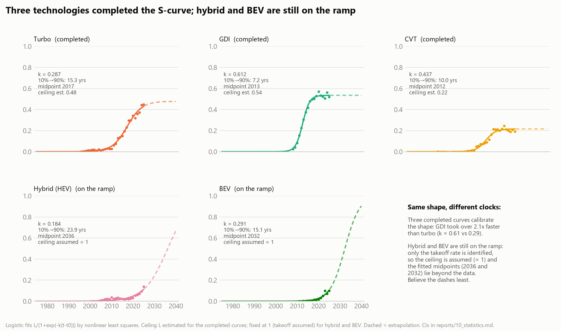
2 DATA UNDERSTANDING: FUTURE TRENDS
Efficiency technology arrives on S-curves; hybrid and electric are still on the ramp
Three technologies have run the whole course and each traced the same S; only the clock speed differs. Direct injection took over 2.1× faster than turbocharging.
Hybrid and electric are on the ramp: the data pin down how fast they are taking off (10→90% in 24 and 15 years), not where they stop. The ceiling is assumed, the midpoints (2036, 2032) lie beyond the data, and the dashed lines are the least reliable thing in this deck.
Whatever the ceiling, every one of these technologies raises MPG at a given weight and power. That is the productivity we will measure.
Source: EPA Automotive Trends technology-share series, 1975–2024; logistic fits with bootstrap confidence intervals; ceiling estimated for completed curves, assumed for hybrid and BEV; dashed = extrapolation.
Notes:
One more piece of context before the model: how does efficiency technology actually arrive in the fleet? The answer, over fifty years, is on S-curves. Slow uptake, then a rush, then saturation. The top row shows three technologies that have run the whole course. Turbocharging took fifteen years to go from ten to ninety percent of its eventual share. Direct injection did it in seven. Continuously variable transmissions in ten. Same shape every time; only the clock speed differs, and that is what 'rate constant' means. The bottom row is the two technologies still on the ramp. Hybrids sit at about ten percent of the fleet today. When we fit the same S-curve, the midpoint lands in 2036 and the ten-to-ninety climb takes about twenty-four years, so what you see is the bottom corner of an S whose middle hasn't happened yet. Electrics are on the same footing: thirteen years of data, a fitted midpoint of 2032, a fifteen-year climb. For both, the data pin down how fast they are taking off, not where they stop, so the ceiling is an assumption and the dashed lines are the least reliable thing in this deck. What every one of these technologies has in common is the part that matters for us: each raises fuel economy at a given weight and power. That is the quantity we are about to measure. To measure it we need to know exactly which numbers go into the equation and where each one came from.
IF ASKED why fit an S to hybrids or electrics at all: the three completed technologies gave no reason to expect a different shape, and the logistic is the standard diffusion model. For the completed curves the ceiling is estimated (turbo 48%, direct injection 54%, CVT 22%); for the two on the ramp the data cannot identify a ceiling, so it is fixed at one and only the rate and midpoint are estimated, with bootstrap confidence intervals. A free fit for electrics flips between an early S-curve and a low plateau depending on the last two data points, which is exactly why we do not report one.

Slide 8
3 X AND Y VARIABLE DETERMINATION: THE DATA
Two EPA datasets: the 50-year fleet record, and 1,285 model types for 2024
Field | Role | Source file | Notes
Combined MPG / MPGe, unadjusted 2-cycle | Dependent variable (y) | EPA MY2024 Fuel Economy & Technology file | Same test for every vehicle; MPGe = miles per 33.7 kWh for electrics
CAFE inertia weight (lbs) | Independent (x) | same file | test weight class
Rated horsepower | Independent (x) | same file; EPA MY2024 Test Car List for electrics | the FE file leaves HP blank for BEVs; 96% joined from the Test Car List
Powertrain: hybrid, battery-electric | Independent (x), 0/1 flags | same file (HYBRID_YN, FUEL_USAGE) | gasoline/diesel is the reference group
Footprint (sq ft) | Tested, then dropped | EPA MY2024 Footprint file | adds nothing once weight is in (t = 0.1); kept in backup
Fleet MPG, weight, HP, class, technology shares, 1975–2024 | Context and normalization | EPA Automotive Trends Report | production-weighted; 2025 preliminary year excluded
CO2, displacement, cylinders, transmission, drive, volumes, ~140 others | Excluded | same files | collinear with weight/HP, or not physical design
n = 1,285 model types in the equation: 775 gasoline/diesel, 250 hybrid, 260 battery-electric. 256:1 observations per estimated parameter (course rule of thumb: 10:1). Ranges: MPG-equivalent 11–199, weight 2,250–9,000 lbs, horsepower 78–1,839.
Sources: EPA Automotive Trends data downloads (MY2024 fuel-economy, footprint, and Test Car List files; fleet report tables). Links on the Data Links slide.
Notes:
Here is what we actually used and where it came from. Two EPA datasets. The first is the Automotive Trends fleet record: one production-weighted number per year for MPG, weight, horsepower, class shares and technology shares, 1975 to 2024. That gave us the history you just saw and it will give us the normalization later. The second is the 2024 compliance filing: every model type manufacturers legally filed for model year 2024, one row each, twelve hundred eighty-five of them once we require the fields the equation needs. That is the regression dataset. The dependent variable is combined fuel economy on the EPA's unadjusted two-cycle test, the one test applied identically to every vehicle; for electrics it is the miles-per-gallon-equivalent version of the same test. The independent variables are inertia weight, rated horsepower, and two powertrain flags, hybrid and battery-electric, with gasoline and diesel as the reference. One wrinkle: the fuel-economy file leaves horsepower blank for every electric vehicle, so we joined it from the EPA's Test Car List, matching ninety-six percent of electric model types; we validated the same join on gasoline rows where horsepower is already known, and it reproduces the filed figure within ten percent for eighty-seven percent of rows. We tested footprint and dropped it: with weight in the model it explains nothing. We excluded about a hundred and forty other fields, most of them either collinear with weight and power or not physical design at all: CO2, displacement, cylinder count, transmission, drive type, production volumes.
IF ASKED what '2-cycle' means: the EPA's two laboratory dynamometer cycles, a simulated stop-and-go city drive and a steady highway drive, blended 55/45. 'Unadjusted' means the raw lab result with no correction toward real-world driving; it is the measurement CAFE compliance uses. Window stickers use five cycles and read lower.
IF ASKED about the two files being joined: the fuel-economy file and the footprint file matched 100% on the manufacturer-division-carline key, and the Test Car List matched 96% of electric model types on carline name and test group. The 4% unmatched are Fisker Ocean and four Porsche Taycan trims, dropped rather than guessed.

Slide 9
3 X AND Y VARIABLE DETERMINATION: HYPOTHESES
One dependent variable, four independent variables, five hypotheses
DEPENDENT VARIABLE (y): combined MPG (MPGe for electrics), EPA unadjusted 2-cycle, one row per Model Year 2024 model type
Variable | H₀ | Hₐ | Expected correlation with MPG
ln(weight) | β₁ = 0 | β₁ < 0 | negative: more mass to accelerate
ln(horsepower) | β₂ = 0 | β₂ < 0 | negative: bigger engine, richer fueling
hybrid | β₃ = 0 | β₃ > 0 | positive: regenerative braking, engine right-sizing
battery-electric | β₄ = 0 | β₄ > 0 | positive: no combustion losses
whole model (F-test) | β₁ = β₂ = β₃ = β₄ = 0 | at least one ≠ 0 | the four together explain MPG
INDEPENDENT VARIABLES (x):
1. Inertia weight (lbs), in logs
2. Rated horsepower, in logs
3. Hybrid powertrain (0/1)
4. Battery-electric powertrain (0/1)
Test: t-test on each coefficient (HC1 robust standard errors), F-test on the whole model, α = 0.05.
Why these four: the scatters on the next two slides show weight and power as the visible drivers; powertrain is the visible vertical split. Footprint was tested and adds nothing once weight is in.
Source: EPA MY2024 compliance data. Signs and hypotheses were written before the model was fit.
Notes:
Now the setup. Our dependent variable, the thing we predict, is combined fuel economy on the two-cycle test, with electrics measured in MPG-equivalent on the same test. Our four independent variables are weight and horsepower, both in logarithms for a reason we will explain on the equation slide, and two zero-one flags: hybrid and battery-electric. Gasoline and diesel are the reference group. We wrote the hypotheses before fitting. For each variable the null hypothesis is that its coefficient is zero, that it has no effect; the alternative is a signed effect: negative for weight and power, positive for hybrid and electric. And one whole-model hypothesis: the null that all four coefficients are zero at once, tested with the F-statistic. We test each coefficient with a t-test using robust standard errors, at the five percent level. Why these four variables and not others? The next two slides show the raw data: weight and power are the visible drivers, and powertrain is the visible vertical split between the clouds. We also tested footprint, the vehicle's shadow on the ground; once weight is in the model it adds nothing, so we left it out and kept the test in backup.
IF ASKED why logs: fuel burn scales multiplicatively with mass moved and power demanded. Taking logs turns a multiplicative law into a straight line that ordinary least squares can estimate, and it makes each coefficient an elasticity: percent change in MPG per percent change in the predictor.

Slide 10
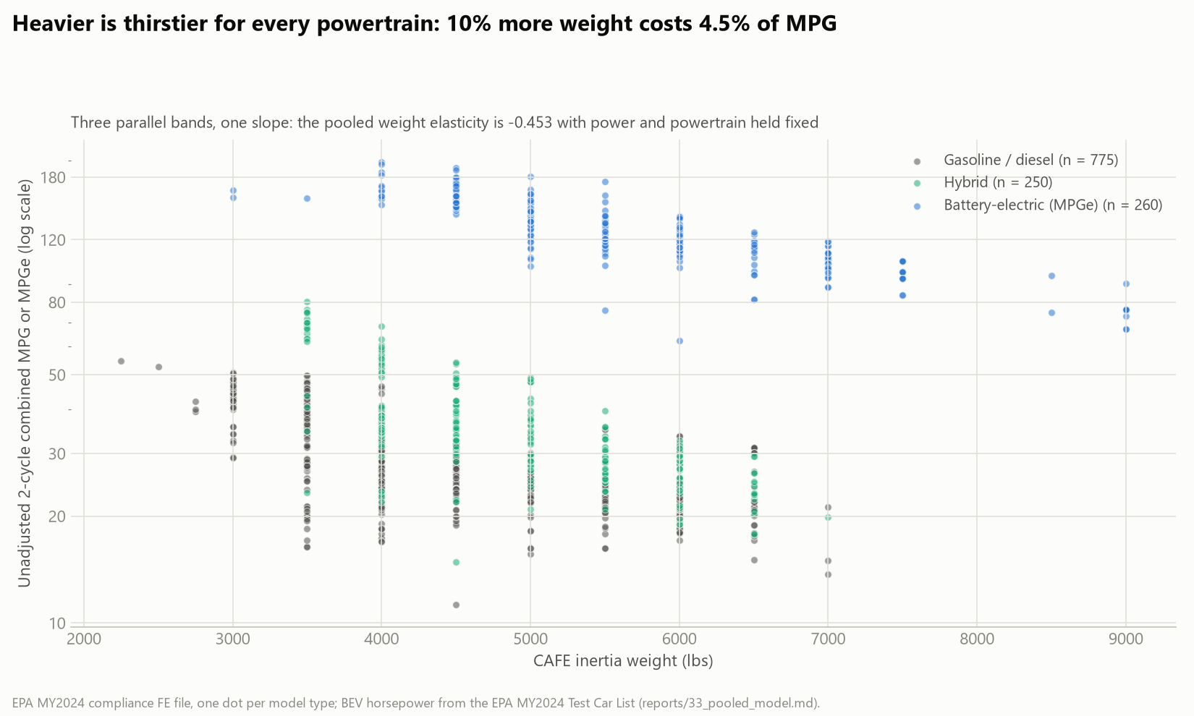
3 X AND Y VARIABLE DETERMINATION: WEIGHT
Heavier is thirstier for every powertrain: 10% more weight costs 4.5% of MPG
Source: EPA MY2024 compliance FE file, one dot per model type; electric horsepower from the EPA MY2024 Test Car List.
Notes:
This is the first raw relationship, before any model. One dot per 2024 model type: weight across, fuel economy up, on a log scale. Three clouds. Gasoline and diesel in grey, hybrids in green, electrics in blue. Two things to see. First, every cloud slopes down: heavier is thirstier, whatever the powertrain. Our fitted elasticity says ten percent more weight costs four and a half percent of fuel economy with power and powertrain held fixed. Second, the clouds are stacked, not mixed: at any weight a hybrid sits above a gasoline car, and an electric sits far above both. That vertical separation is why powertrain has to be in the equation and why one variable cannot do the job alone. Notice also the vertical spread within each cloud at a fixed weight: that spread is what horsepower will explain on the next slide.
IF ASKED about outliers here: the very light gasoline dots at the top left are two-seat minicars; the heavy electric dots at the far right are the electric Hummer and the largest electric pickups. They are real vehicles and they stay in the model.

Slide 11
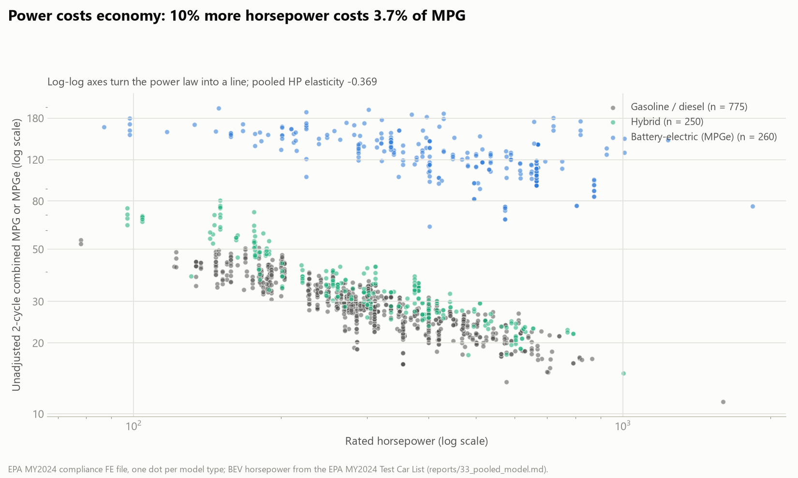
3 X AND Y VARIABLE DETERMINATION: HORSEPOWER
Power costs economy: 10% more horsepower costs 3.7% of MPG
Source: EPA MY2024 compliance FE file; electric horsepower from the EPA MY2024 Test Car List. Both axes logarithmic.
Notes:
The second raw relationship: horsepower. Both axes are logarithmic here, and look at what that does: the gasoline and hybrid clouds become nearly straight lines. That is the signature of a power law, fuel economy proportional to horsepower raised to some negative exponent, and it is the reason we fit the model in logs. In log-log form a curve like this becomes a line, and the slope of the line is the elasticity: about minus zero point three seven, meaning ten percent more horsepower costs three point seven percent of fuel economy. The electric cloud is flatter, which is a real physical fact: an electric motor has no fueling penalty at part load, so power costs electrics less. We will show that formally in backup. Within one equation the horsepower slope is a fleet-wide average, and the electric flag lifts the whole cloud. Note the outlier at the far right, the eighteen-hundred-horsepower electric hypercar; it stays in.
IF ASKED why the log function fits: fuel consumption per mile scales with the mass you accelerate and the power you install, and effects like that multiply rather than add. If MPG is proportional to weight to some power times horsepower to some power, then log MPG is a linear function of log weight and log horsepower. The straight clouds on this slide are the empirical confirmation.

Slide 12
4 OLS MODEL RESULTS AND HYPOTHESIS TESTING: THE EQUATION
The equation: multiplicative physics, estimated as a straight line in logs
ln(MPG) = 9.26 − 0.453·ln(weight) − 0.369·ln(HP) + 0.224·hybrid + 1.708·electric + ε
1
2
3
Why logs
Fuel burn scales with mass moved and power demanded, so effects multiply. Logs turn the multiplicative law into a line ordinary least squares can estimate, and each coefficient becomes an elasticity: % change in MPG per 1% change in the predictor.
What the flags do
A 0/1 flag shifts the whole line. Exponentiate it for a percent premium: hybrid e^0.224 − 1 = +25%; electric e^1.708 − 1 = +452% at identical weight and power. Gasoline/diesel is the baseline.
What ε is
Everything the four variables do not capture: aerodynamics, gearing, tires, calibration. R² = 0.955 means the four explain 95.5% of the variation in ln(MPG); ε carries the other 4.5%. Standard errors are HC1 robust, because spread differs across vehicle classes.
Fit: ordinary least squares on n = 1,285 MY2024 model types; HC1 heteroskedasticity-robust standard errors.
Notes:
Here is the equation, and this is the slide to slow down on. Log of fuel economy equals nine point two six, minus zero point four five three times the log of weight, minus zero point three six nine times the log of horsepower, plus zero point two two four if it is a hybrid, plus one point seven zero eight if it is battery-electric, plus an error term. Three things to explain. First, why logs. Fuel burn scales with the mass you move and the power you demand, and those effects multiply rather than add. Taking logarithms turns that multiplicative physics into a straight line that ordinary least squares can estimate. The bonus is that each coefficient is then an elasticity: the percent change in fuel economy for a one percent change in the predictor. Second, the flags. A zero-one flag does not tilt the line, it shifts it. Exponentiate the coefficient and you get a percent premium: e to the zero point two two four is one point two five, so a hybrid gets twenty-five percent more miles per gallon than a gasoline car of identical weight and power. E to the one point seven zero eight is five point five, so an electric gets four hundred and fifty percent more miles per gallon-equivalent. Third, epsilon. It is everything the four variables do not capture: aerodynamics, gearing, tires, engine calibration. Without it the equation would claim four numbers determine fuel economy exactly, which is false. R-squared of zero point nine five five says the four variables explain ninety-five and a half percent of the variation in log MPG, and epsilon carries the remaining four and a half.
IF ASKED what HC1 means: heteroskedasticity-consistent standard errors. The spread of residuals is not the same across vehicle classes, pickups scatter more than compacts, and plain OLS standard errors assume it is. HC1 corrects the standard errors, and therefore the t-statistics and p-values, without changing the coefficients.

Slide 13
4 OLS MODEL RESULTS AND HYPOTHESIS TESTING: RESULTS
Results: all four predictors reject H₀ and together explain 95.5% of MPG
Term | Coefficient | HC1 SE | t | p | Verdict
intercept | 9.258 | 0.201 | 46.0 | < 0.001 | —
ln(weight) | −0.453 | 0.029 | −15.4 | < 0.001 | reject H₀, sign as expected
ln(horsepower) | −0.369 | 0.015 | −24.6 | < 0.001 | reject H₀, sign as expected
hybrid | +0.224 | 0.011 | 21.0 | < 0.001 | reject H₀, sign as expected
battery-electric | +1.708 | 0.014 | 117.7 | < 0.001 | reject H₀, sign as expected
R² = 0.955
adjusted R² 0.954; n = 1,285; every coefficient with the hypothesized sign
What t tests
Each t is coefficient ÷ standard error: how many standard errors the estimate sits from zero. |t| > 1.96 rejects H₀ at α = 0.05. Ours run 15 to 118.
What F = 6,732 tests
The whole model. H₀: all four coefficients are zero. F = variance explained per parameter ÷ variance unexplained per residual degree of freedom, F(4, 1280). Under H₀ it hovers near 1; ours is 6,732, p < 10⁻¹⁵.
VIF (not covered in class)
Variance inflation factor: how much a predictor's variance is inflated by correlation with the other predictors. 1 = independent, > 10 = trouble. Ours: weight 1.9, HP 1.6, hybrid 1.1, electric 1.4.
Source: stage-33 fit on EPA MY2024 compliance data (reports/33_pooled_model.md). Combustion-only version (R² 0.846) in backup.
Notes:
The results. Every one of the four predictors rejects its null hypothesis, and every one carries the sign we wrote down before fitting. Read the t column: a t-statistic is the coefficient divided by its standard error, so it counts how many standard errors the estimate sits away from zero. Anything beyond about two rejects at the five percent level. Ours run from fifteen to one hundred eighteen. The p-values are all below one in a thousand. The whole-model F-statistic is six thousand seven hundred; that tests the null hypothesis that all four coefficients are zero at once. F is the variance the model explains, per parameter, divided by the variance it leaves unexplained, per residual degree of freedom, here four and twelve hundred eighty. Under the null it hovers around one. Six thousand seven hundred is the ANOVA machinery from the course saying this model is not noise. R-squared is zero point nine five five, adjusted zero point nine five four. One statistic the course did not cover: VIF, the variance inflation factor, which measures how much each predictor's variance is inflated by its correlation with the others. One means independent; above ten is a problem. Ours top out at one point nine. Weight and horsepower are correlated, but not enough to destabilize anything.
IF ASKED how F gets to 6,732: R-squared over its four degrees of freedom, divided by one minus R-squared over twelve hundred eighty residual degrees of freedom. Zero point nine five five over four is zero point two three nine; zero point zero four five over twelve hundred eighty is three point five times ten to the minus five; the ratio is about six thousand seven hundred.
IF ASKED why the combustion-only version has a lower R-squared (0.846): adding electrics adds a huge, cleanly explained vertical separation, so the share of variance the model explains rises. Within the gasoline cloud alone the fit is the same physics with less total variance to explain.

Slide 14
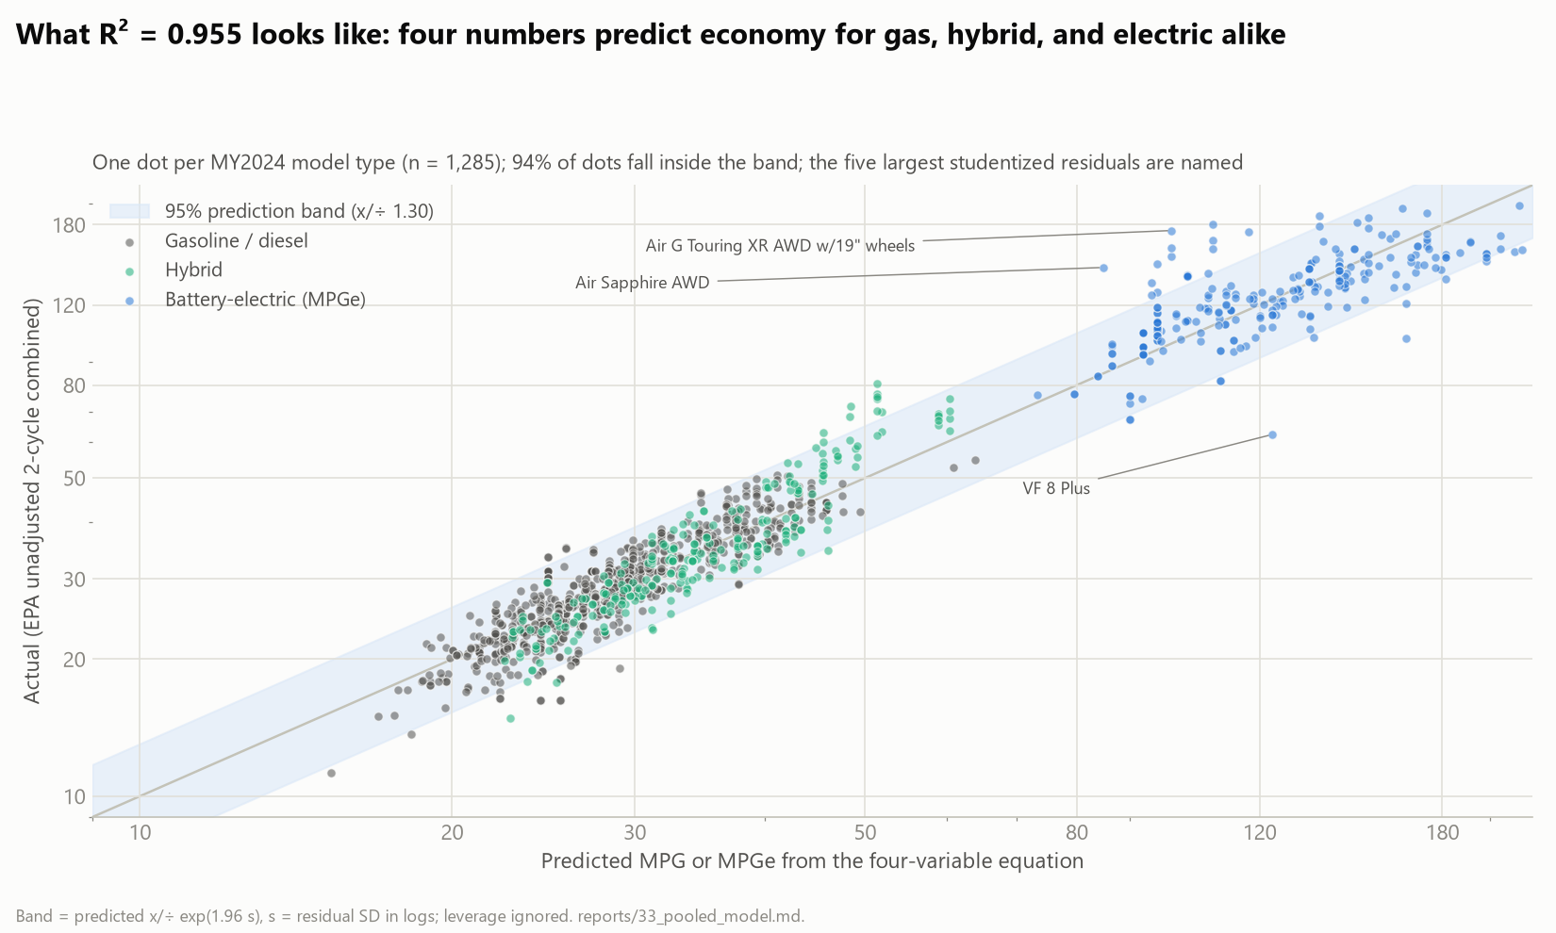
4 OLS MODEL RESULTS AND HYPOTHESIS TESTING: FIT AND OUTLIERS
What R² = 0.955 looks like: 94% of vehicles land inside a ±30% band
Source: stage-33 fit; band = predicted × / ÷ e^(1.96·s), s = residual standard deviation in logs (0.135).
Notes:
This is what that R-squared looks like. Predicted fuel economy across, actual up, one dot per model type, the diagonal is perfection. The shaded band is the ninety-five percent prediction band: predicted times or divided by one point three. Ninety-four percent of vehicles land inside it. A typical miss is about fourteen percent, which for a thirty-MPG car is four MPG, from four numbers on a spec sheet. Now the outliers, because there are a few and they are interesting. The five largest studentized residuals are named. The Lucid Air, above the band, is a genuine aerodynamic champion: it gets far more range per kilowatt-hour than its weight and power predict. The VinFast VF 8, below the band, is the opposite, a heavy SUV that delivers half the efficiency its design predicts. The Fiat 500e is over-predicted because the equation extrapolates into three-thousand-pound electric territory where almost nothing else exists. We found two more outliers that turned out to be errors in the EPA file itself: the Audi Q4 e-tron and the Tesla Model S Plaid had their MPGe and kilowatt-hours-per-hundred-miles cells swapped. We corrected them from the EPA's own paired values, and both now sit on the line. Every correction is logged.
IF ASKED what a studentized residual is: the residual divided by its own standard error, so residuals from points with different leverage are on a comparable scale; values beyond about three are worth a look.

Slide 15
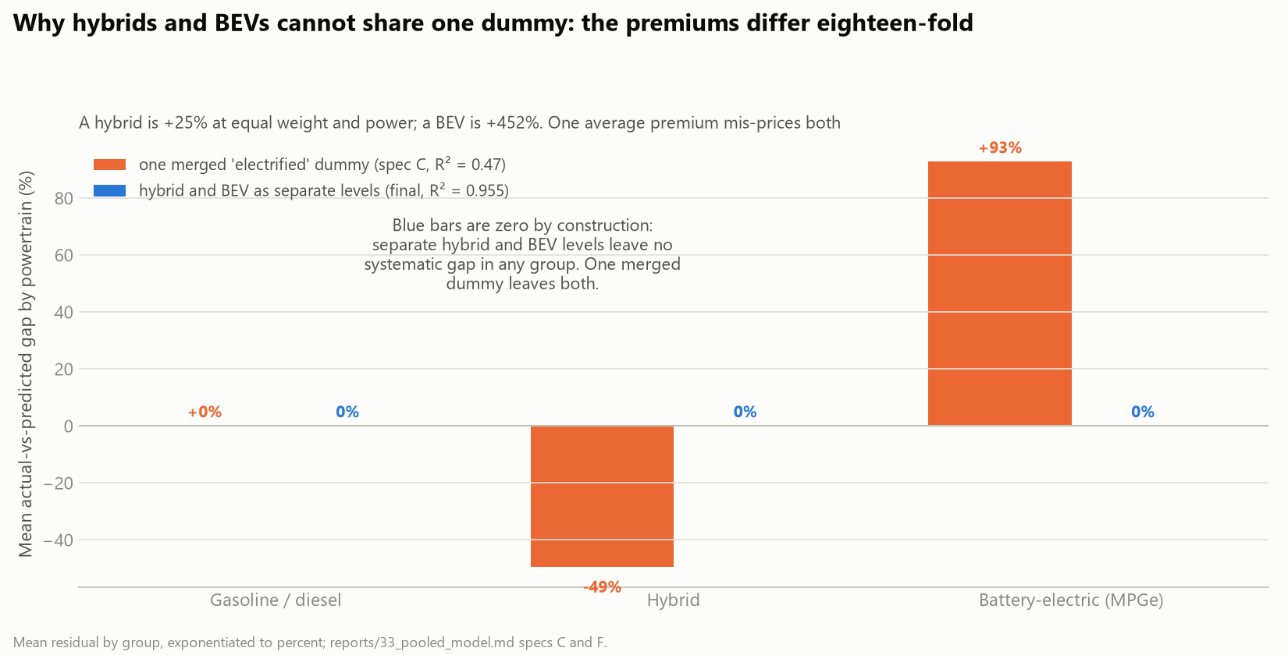
4 OLS MODEL RESULTS AND HYPOTHESIS TESTING: ONE EQUATION FOR EVERY POWERTRAIN
Hybrids and electrics cannot share one flag: their premiums differ eighteen-fold
The tempting shortcut: one 'electrified' flag for hybrids and BEVs together. R² collapses to 0.47 and the weight sign flips: the flag under-predicts every BEV by 93% and over-predicts every hybrid by 49%.
The test: nested F(1, 1279) = 13,798, p < 10⁻¹⁵ for splitting the flag in two.
Result: one equation, one powertrain variable with three levels (gasoline/diesel, hybrid, electric). Electrics are in the model, not beside it.
Source: stage-33 specifications C (merged flag) and F (final); mean residual by powertrain, exponentiated to percent.
Notes:
We want to show one modeling decision explicitly, because it is the kind of choice this course is about. We wanted electrics inside the equation, not modeled separately. The tempting shortcut is a single 'electrified' flag covering hybrids and electrics together, one variable instead of two. We fit it. R-squared collapses from zero point nine five five to zero point four seven, and the weight coefficient flips sign. The chart shows why: one average premium under-predicts every electric by ninety-three percent and over-predicts every hybrid by forty-nine percent, because a hybrid is worth twenty-five percent and an electric four hundred and fifty. The formal test is a nested F-test on the extra parameter: F of thirteen thousand eight hundred, so the split is not optional. The resolution is to treat powertrain as one categorical variable with three levels, gasoline-diesel, hybrid, electric, which is the standard way a regression carries a category. That keeps the equation at four independent variables and puts electrics in the model rather than beside it.
IF ASKED whether electrics obey the same weight and power physics: not exactly, and backup shows it. Allowing electric-specific slopes gives a weight elasticity near minus one and a horsepower elasticity near zero for electrics. The common-slope equation is a fleet-wide compromise that fits at 0.955; the interaction model fits at 0.968. We chose the simpler one for the story and kept the richer one in backup.

Slide 16
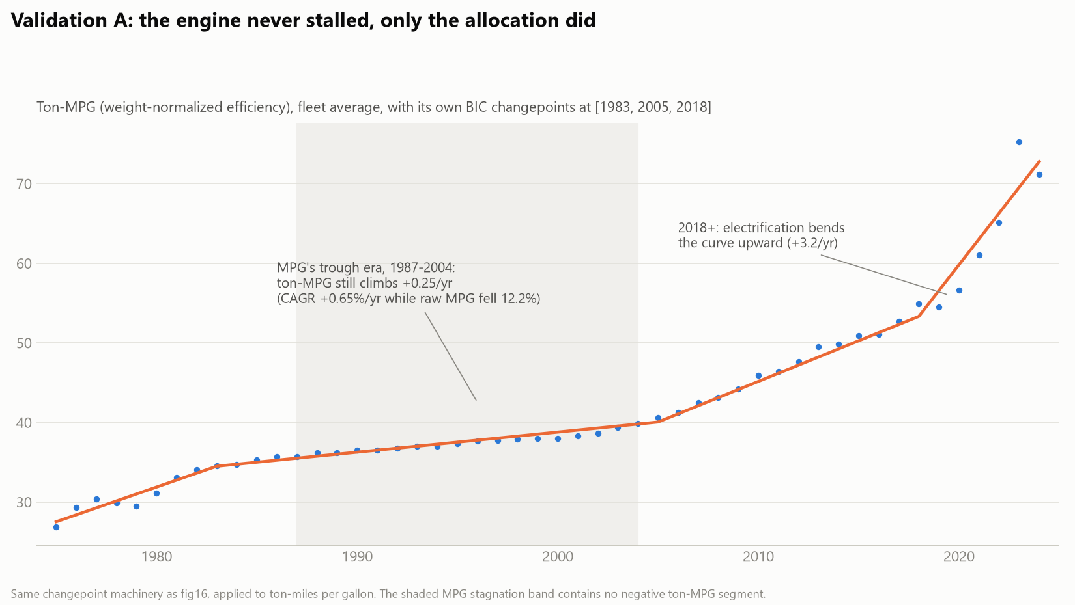
5 MPG NORMALIZATION: WHY
The exchange rate: what mass, power, and powertrain cost or buy in MPG
−4.5%
−3.7%
+25%
+452%
MPG per 10% more weight, holding power and powertrain fixed
MPG per 10% more horsepower, the price of acceleration
hybrid premium at identical weight and power
battery-electric premium, same basis (in MPG-equivalent)
Why this lets us normalize: the 1987–2004 fleet gained ~900 lbs and ~90 HP. The elasticities price what that cost: the industry spent its efficiency gains on safety and acceleration at roughly 0.4% of MPG per 1% of horsepower. A first check (left): weight-normalized efficiency, ton-MPG, climbed every single year of the trough. The next slide does the normalization properly, with both elasticities.
Elasticities from the stage-33 equation. Left chart: EPA Trends fleet MPG × fleet weight (ton-MPG), with algorithmic changepoints.
Notes:
Now the second use of the equation, which is the one we find most interesting. The coefficients are exchange rates. Ten percent more weight costs four and a half percent of fuel economy. Ten percent more horsepower costs three point seven. A hybrid buys twenty-five percent at the same weight and power; an electric buys four hundred and fifty. Remember the seventeen-year stall we started with: the fleet gained nine hundred pounds and ninety horsepower. The elasticities say what that cost, and the answer is: roughly all of the efficiency progress of those years. The industry was not standing still; it was spending its gains on safety and acceleration. The small chart on the left is a first, crude check: multiply fleet MPG by fleet weight, which is ton-MPG, and that weight-normalized efficiency climbed every single year of the trough. The next slide does the normalization properly, using both elasticities from our own equation.

Slide 17
5 MPG NORMALIZATION: HOW
How we normalized: the equation re-prices every year at 2024's design
1
2
3
Take each year's fleet averages
EPA Trends gives the production-weighted average MPG, weight, and horsepower of every model year's fleet, 1975–2024.
Re-price it at 2024's weight and power
Multiply that year's MPG by (weight ÷ 2024 weight)^0.453 × (HP ÷ 2024 HP)^0.369. Lighter, weaker fleets get scaled down; the exponents are our own elasticities.
What is left is technology
Every year now describes the same vehicle, 2024's fleet weight and power, built with that year's engineering. One moving part instead of three.
Worked example, 1987: raw fleet MPG 22.0, but the average 1987 vehicle weighed 3,221 lbs with 118 HP; the average 2024 vehicle weighs 4,354 lbs with 258 HP.
22.0 × (3221 / 4354)^0.453 × (118 / 258)^0.369 = 22.0 × 0.872 × 0.748 ≈ 14.3
1987's technology, asked to move 2024's fleet, delivers about 14 MPG, not 22. That is the normalized point plotted for 1987 on the next slide.
Construction in 29_productivity.py; elasticities from the stage-33 equation. Assumption, stated in Limitations: 2024 elasticities held across eras.
Notes:
Here is exactly how the normalization works, in three steps. Step one: the EPA fleet record gives us, for every model year, the production-weighted average fuel economy, average weight, and average horsepower of the vehicles built that year. Step two: we use our equation to re-price each year at 2024's design. The equation says fuel economy scales as weight to the minus zero point four five three times horsepower to the minus zero point three six nine. So we multiply that year's fuel economy by the ratio of its weight to 2024's weight, raised to zero point four five three, times the ratio of its horsepower to 2024's, raised to zero point three six nine. A lighter, weaker fleet has both ratios below one, so its fuel economy is scaled down, by exactly the advantage the equation says lightness and weakness were worth. Step three: what remains is a series in which every year describes the same hypothetical vehicle, 2024's weight and power, built with that year's engineering. The design has been held constant; only the technology moves. The worked example: in 1987 the fleet averaged twenty-two miles per gallon, but the average vehicle weighed thirty-two hundred pounds with a hundred and eighteen horsepower, against forty-three hundred and two fifty-eight today. Twenty-two times zero point eight seven times zero point seven five is fourteen point three. Nineteen eighty-seven's technology, asked to move today's fleet, would have delivered about fourteen miles per gallon. That is the normalized point for 1987.
IF ASKED what 'the elasticities we estimated' means: the two exponents, 0.453 and 0.369, are the weight and horsepower coefficients from the regression on the results slide. Because the model is in logs, they transfer directly into these ratio-to-a-power factors; that is the whole reason the log form is convenient here.
IF ASKED why 2024 as the base: any year works and just shifts the whole curve; 2024 makes the endpoint equal today's actual fleet so the numbers read in today's terms.

Slide 18
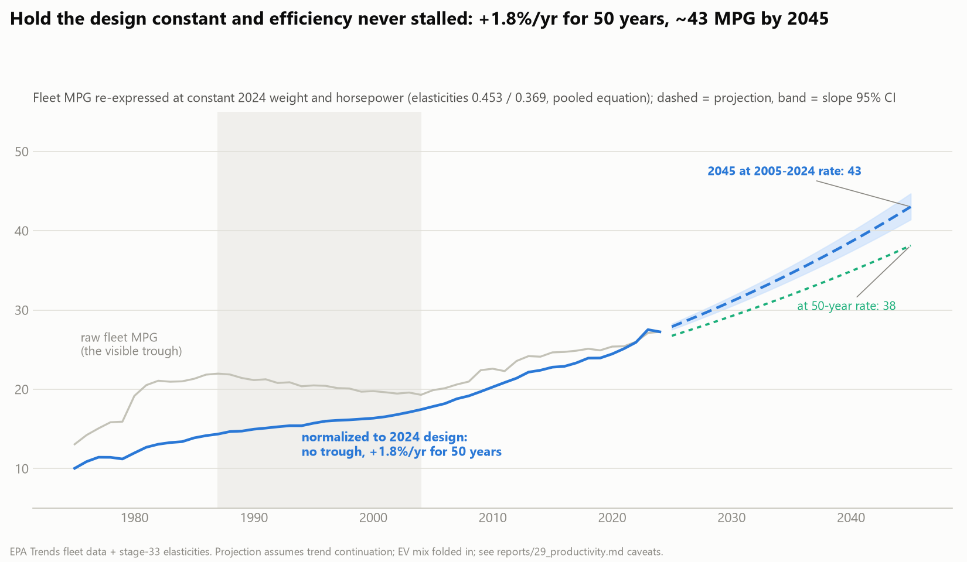
6 MPG NORMALIZATION AND WHAT IT SAYS ABOUT THE FUTURE
Hold the design constant and efficiency never stalled: +1.8%/yr for 50 years, 38–43 by 2045
MPG_norm = MPG × (wt/wt₂₀₂₄)^0.453 × (HP/HP₂₀₂₄)^0.369
The trough vanishes: 10.0 → 14.3 → 17.4 → 27.2 for 1975 / 1987 / 2004 / 2024, monotone. Technology never paused; its gains were spent.
+1.79%/yr, R² = 0.980 on 50 annual points; +2.19%/yr since 2005. At trend: 35 by 2035, 38–43 MPG-equivalent by 2045, bracketed by the two rates.
Two different R²: 0.955 is how well four design numbers predict one vehicle's economy (1,285 vehicles). 0.980 is how straight this 50-year trend line is (50 years). Different regressions; not comparable and not contradictory.
Source: EPA Trends fleet averages 1975–2024 normalized with the stage-33 elasticities; shaded band = 95% CI on the trend slope; dashed = extrapolation.
Notes:
And here is the payoff. The grey line is the raw fleet fuel economy you saw at the start, with its seventeen-year trough. The blue line is the same fleet re-priced at 2024's weight and power using our equation. The trough is gone. Normalized productivity runs ten, fourteen, seventeen, twenty-seven for 1975, 1987, 2004, 2024, and it never goes backward. Technology never paused; the industry spent its gains on heavier, faster vehicles. And the line is remarkably straight in log space: one point eight percent a year for fifty years, with an R-squared of zero point nine eight on fifty annual points, and two point two percent a year since 2005. Extend the trend and the fleet reaches about thirty-five MPG-equivalent by 2035 and between thirty-eight and forty-three by 2045, the two rates bracketing the range. One thing we want to head off: you have now seen two R-squareds, zero point nine five five and zero point nine eight. They are from two different regressions. The first is how well four design numbers predict one vehicle's economy across twelve hundred vehicles. The second is how straight this fifty-year trend line is across fifty years. Not comparable and not contradictory.
IF ASKED what the shaded band is: the ninety-five percent confidence interval on the trend slope, centered on the fit window, so it reflects fit uncertainty only. Scenario uncertainty, what regulators and buyers do, is far larger and is not in the band.
IF ASKED whether this is just electrification: partly, in the last decade, since fleet MPG folds electric MPGe in. Backup shows the same normalization on the combustion-only fleet: plus one point nine percent a year, the same clock.

Slide 19
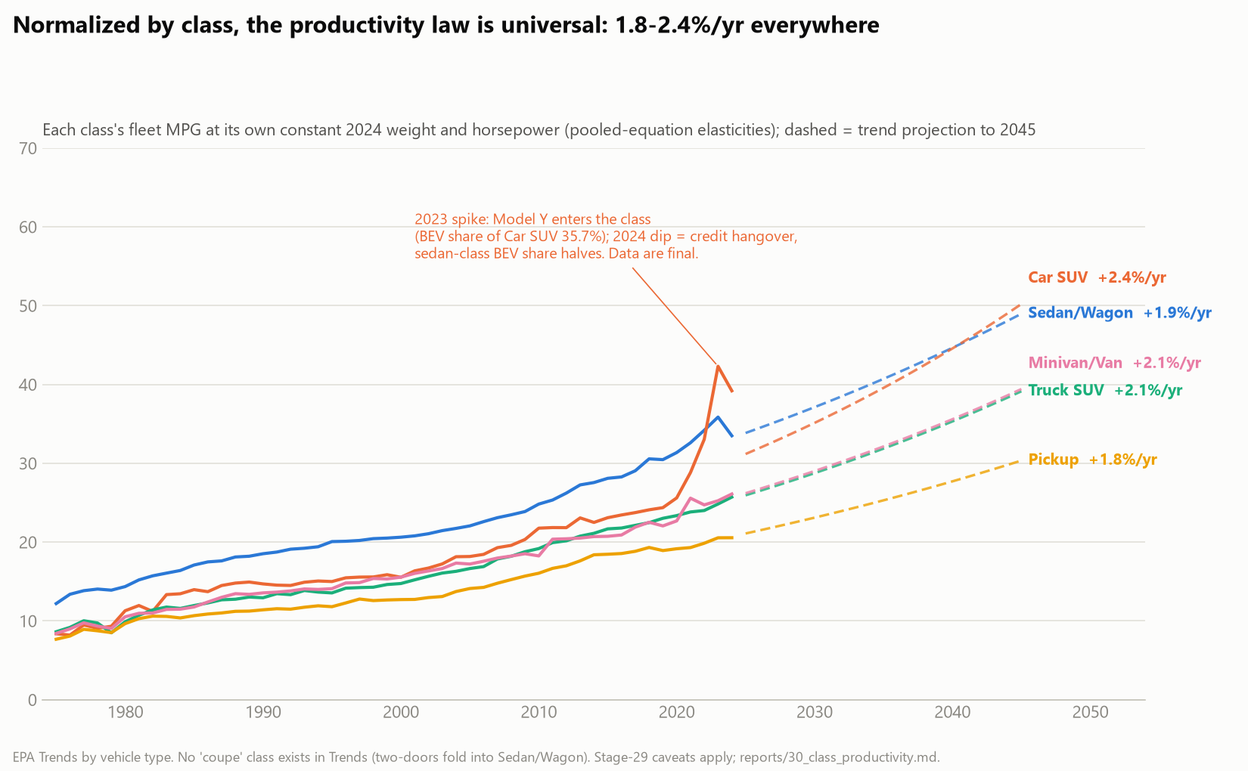
6 MPG NORMALIZATION AND WHAT IT SAYS ABOUT THE FUTURE: BY CLASS
Every class of vehicle improves on the same clock: 1.8–2.4% a year, normalized
Sedans, car SUVs, truck SUVs, pickups, minivans, each normalized to its own 2024 weight and power: 1.8–2.4%/yr everywhere, R² 0.92–0.98.
Classes differ in level (a pickup's physics), barely in rate.
The Car SUV spike in 2023 is the Model Y arriving at 36% of the class; the 2024 dip is the credit hangover. Both are mix, not missing data: 2024 is final. Remove electrics and the spike is gone (backup).
Source: EPA Trends by vehicle type, 1975–2024; no coupe class exists in the EPA data (two-doors fold into Sedan/Wagon).
Notes:
Does the productivity law hold within each kind of vehicle, or is it an artifact of the mix shifting? Here is every EPA vehicle class normalized to its own 2024 weight and power. Sedans, compact SUVs, truck SUVs, pickups, minivans: every one improves between one point eight and two point four percent a year, with R-squareds from zero point nine two to zero point nine eight. The classes differ in level, a pickup will never match a sedan, but barely in rate. The one feature to explain is the orange spike in 2023, and we can explain it exactly: that is the Tesla Model Y entering the compact-SUV class at thirty-six percent of the class, the credit-driven surge from the EV slide. The 2024 dip is the hangover. Both are the sales mix moving, not missing data; 2024 is final in the EPA record. In backup we remove electrics from every class and the spike disappears.

Slide 20
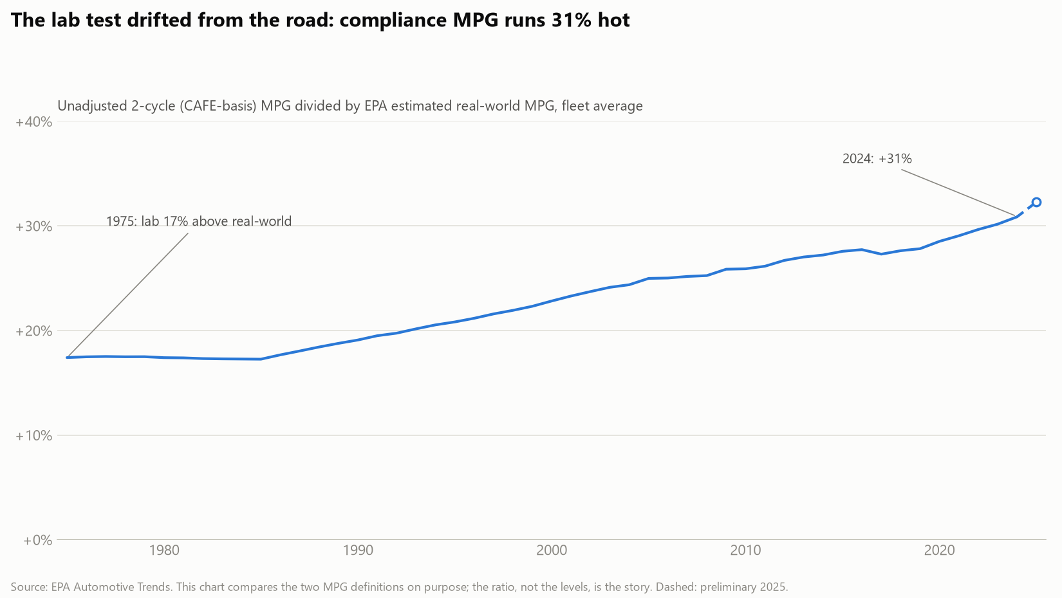
7 FINAL RESULTS AND FUTURE PREDICTIONS: LIMITATIONS
Limitations, stated plainly
Cross-sectional elasticities applied across time. Estimated on the 2024 fleet, applied to five decades for normalization: a stability assumption, partially supported by era refits of the combustion model (R² 0.71–0.78).
Lab MPG, not the window sticker. The dependent variable is the unadjusted 2-cycle test, a consistent basis that runs ~31% above real-world driving by 2024 (chart at right).
Projections are trend extrapolations. Log-linear, no physics ceiling, no policy scenario; the band carries fit uncertainty only, and scenario uncertainty dominates.
The lab-vs-road gap, 1975–2024 (EPA Trends 2-cycle vs real-world estimate)
Electric horsepower and units. BEV horsepower joined from the EPA Test Car List (96% matched; 4% dropped, not imputed); two BEV rows corrected from EPA's own paired kWh values; common weight/HP slopes are a fleet-wide compromise (BEV-specific slopes in backup).
Full limitation notes: reports/33_pooled_model.md, 29_productivity.md, 31_ice_productivity.md.
Notes:
Before the conclusion, four limitations we would rather raise ourselves. First, the elasticities are cross-sectional: estimated on the 2024 fleet and applied back across five decades. That assumes the exchange rate between weight, power, and economy has been stable. Refitting the combustion model on earlier catalog years gives R-squareds of zero point seven one to zero point seven eight with similar coefficients, which supports but cannot prove stability. Second, our dependent variable is the laboratory two-cycle result, not the window sticker and not real-world driving. It is the right choice for physics, one consistent test for every vehicle, but it runs about thirty percent above what drivers see, and that gap has widened over time, as the chart shows. Third, the projections are trend extrapolations: straight lines in log space with no physics ceiling and no policy scenario. The shaded band is fit uncertainty only. Fourth, the electric-specific data work: horsepower for electrics came from a second EPA file with a ninety-six percent match, and the four percent we could not match were dropped rather than guessed; two electric rows had swapped units in the EPA file and were corrected from the EPA's own paired values; and the common weight and horsepower slopes are a fleet-wide compromise, since electrics obey somewhat different physics, which backup shows.

Slide 21
7 FINAL RESULTS AND FUTURE PREDICTIONS
Predict the vehicle, predict the wallet, predict the fleet
0.955
+1.8%/yr
38–43
R² of the four-variable equation on 1,285 Model Year 2024 vehicles: gasoline, hybrid, and electric, one equation
fifty years of design-normalized efficiency productivity, never interrupted, trend R² 0.980
MPG-equivalent by 2045 at trend, against 27 today
The chain this equation unlocks:
design → MPG → cost per mile → what consumers buy → the national fleet's fuel economy.
Back to the opening bill: at 2024 prices the median gasoline vehicle costs $2,463 a year to fuel and the median electric $1,007. Every point of fleet MPG the trend delivers is that gap closing for whoever buys the average vehicle; the sales mix decides how fast.
Questions
Notes:
To close. Three numbers. Zero point nine five five: four numbers from a spec sheet, weight, horsepower, and two powertrain flags, predict a vehicle's fuel economy across gasoline, hybrid, and electric alike, in one equation. Plus one point eight percent a year: when we use that equation to hold the fleet's design constant, fifty years of efficiency progress turn out to be a single uninterrupted line; the famous stall was the industry spending its gains on safety and acceleration. Thirty-eight to forty-three: where that line puts the fleet in 2045, against twenty-seven today. The chain that makes this useful runs from design to MPG to cost per mile to what consumers buy to the national fleet's fuel economy, and the equation quantifies the first link so the rest can be forecast. Which brings us back to the bill we opened with: twenty-five hundred dollars a year for the median gasoline vehicle, a thousand for the median electric. Every point of fleet MPG the trend delivers closes that gap for whoever buys the average vehicle; how fast is up to the sales mix. Thank you. Questions.

Slide 22
8 DATA LINKS
Every dataset, where it came from, and what it fed
Dataset | Publisher / link | Used for
Automotive Trends Report data (fleet averages by year, class, manufacturer; technology shares), MY1975–2025 | EPA, epa.gov/automotive-trends/explore-automotive-trends-data | 50-year history, classes, EV shares, S-curves, normalization
Model Year 2024 Fuel Economy & Technology data; MY2024 Footprint data | EPA, epa.gov/automotive-trends (data downloads) | the regression dataset: MPG/MPGe, weight, HP, powertrain; footprint test
Model Year 2024 Test Car List | EPA, epa.gov/compliance-and-fuel-economy-data/data-cars-used-testing-fuel-economy | rated horsepower for battery-electric model types
fueleconomy.gov bulk vehicle catalog, MY1984–2027 | US DOE / EPA, fueleconomy.gov/feg/download.shtml | energy cost per mile, era refits, offered-vs-bought
Gasoline and electricity prices, CPI, vehicle miles traveled, auto sales, loan rates | BLS, FHWA, BEA, Federal Reserve via FRED, fred.stlouisfed.org | annual fuel bills, price-shock exposure, context
Motor-vehicle safety Table 2-17; fleet age Table 1-26 | BTS National Transportation Statistics, bts.gov | fatality rate behind the weight story
Average transaction prices and EV premium, July 2026 | Kelley Blue Book / Cox Automotive, coxautoinc.com | $49,855 ATP; $6,477 EV premium; payback
Trim-level MSRP sample, 2015–2020 | CarAPI sample datafeed, carapi.app | sticker history (backup)
Full pipeline, checksums, and every figure | github.com/SCherwonik/OS3180 (DATA_SOURCES.md, reports/) | reproducibility: 34 numbered scripts, rerun end to end
Notes:
For anyone who wants to check our work: every dataset, its publisher, and what it fed. Two EPA files carry the regression, a third EPA file supplies electric horsepower, the EPA fleet report carries the fifty-year history, and the price and safety series come from the Bureau of Labor Statistics, the Federal Reserve's FRED database, the Bureau of Transportation Statistics, and Kelley Blue Book. The whole pipeline, thirty-four numbered scripts with checksums on every raw file, is on GitHub and reruns end to end.

Slide 23
BACKUP Acronyms and terms
MPG | miles per gallon of gasoline
MPGe | miles per gallon-equivalent: miles per 33.7 kWh of electricity, the energy in one gallon
BEV | battery-electric vehicle
Hybrid (HEV) | gasoline engine plus electric motor; charges itself
PHEV | plug-in hybrid; its gasoline-mode rows count as hybrid here
ICE | internal-combustion engine (gasoline or diesel)
EPA / CAFE | Environmental Protection Agency / Corporate Average Fuel Economy standards
2-cycle / 5-cycle | EPA lab tests: city + highway (compliance) / plus high-speed, A/C, cold (window sticker)
Inertia weight | the test-weight class a vehicle is dynamometer-tested at
Footprint | wheelbase × track width, sq ft; the vehicle's shadow
ATP / MSRP | average transaction price / manufacturer's suggested retail price
DV / IV | dependent variable (y, predicted) / independent variable (x, predictor)
H₀ / Hₐ | null hypothesis / alternative hypothesis
OLS | ordinary least squares regression
HC1 | heteroskedasticity-consistent (robust) standard errors
SE, t, p | standard error; t = coefficient ÷ SE; p = probability of |t| that large under H₀
F | whole-model test statistic: explained variance per parameter ÷ unexplained per residual df
R², adjusted R² | share of variance explained; adjusted penalizes extra predictors
VIF | variance inflation factor, a multicollinearity diagnostic (1 = independent)
Elasticity | % change in y per 1% change in x; the coefficient in a log-log model
ε | the error term: what the predictors do not capture
Studentized residual | residual ÷ its standard error; comparable across points
BIC, KS, Gini | Bayesian information criterion; Kolmogorov–Smirnov test; concentration index (backup slides)
Notes:
Glossary for questions. Two worth having ready: MPGe is miles per thirty-three point seven kilowatt-hours, the energy content of a gallon of gasoline, so it puts electrics on the same energy basis as MPG. And VIF, which the course did not cover, is simply one over one minus the R-squared of regressing a predictor on the other predictors.

Slide 24
BACKUP The relationship survives every specification we tried
Specification | Dataset | n | R²
FINAL: log-log, weight + HP + hybrid + electric | EPA MY2024 compliance, all powertrains | 1,285 | 0.955
+ footprint (t = 0.1, p = 0.87; nested F = 0.03) | same | 1,285 | 0.955
+ electric-specific weight/HP slopes (nested F(3,1276) = 179) | same | 1,285 | 0.968
one merged 'electrified' flag instead of two | same | 1,285 | 0.465
ordinal electrification 0 / 1 / 2 | same | 1,285 | 0.814
Combustion only: weight + HP + footprint + hybrid | EPA MY2024 compliance, gas/diesel/hybrid | 1,025 | 0.846
Combustion only, linear MPG instead of ln | same | 1,025 | 0.804
Catalog model, years 2000+ | fueleconomy.gov catalog | 30,659 | 0.777
Catalog model, years 2020+ | fueleconomy.gov catalog | 7,890 | 0.710
BEV alone: MPGe on weight only | EPA MY2024, true BEVs | 153 | 0.708
Three findings inside the table:
Footprint earns nothing once weight is in: its coefficient is indistinguishable from zero.
Electrics obey their own slopes (weight ≈ −1.05, HP ≈ 0); the common-slope equation is a fleet-wide compromise that still fits at 0.955.
2020+ catalog R² dips because engine downsizing compressed displacement variance: the fleet homogenized, not the physics.
reports/33_pooled_model.md (specs A–F) and reports/19_final_model.md; catalog era fits in SHORTSTORY.md.
Notes:
Use for any 'does it generalize?' or 'why not include X?' question. The final equation is the first row; every alternative we fit is below it with its R-squared.

Slide 25
BACKUP Electrics obey their own physics: weight elasticity −1.05, horsepower elasticity ≈ 0
Group | Weight elasticity | HP elasticity | Reading
Gasoline / diesel / hybrid (combustion) | −0.304 | −0.483 | power is the steepest lever: a bigger engine burns more at every load
Battery-electric (own slopes) | −1.05 | −0.01 | nearly unit-elastic in mass; installed motor power is free at part load
Pooled equation (common slopes, the deck's) | −0.453 | −0.369 | a production-weighted compromise; fits at R² 0.955 vs 0.968 with own slopes
Test: adding electric × ln(weight), electric × ln(HP), electric × footprint to the final equation: nested F(3, 1276) = 179, p < 10⁻¹⁵. Electrics do not share the combustion slopes.
Why it makes physical sense: a combustion engine's efficiency falls at part load, so installed horsepower costs fuel even when unused. An electric motor's does not, so horsepower is nearly free; mass, through rolling resistance and acceleration energy, is everything.
Why the deck uses common slopes anyway: one equation, four variables, one story; the cost is 1.3 points of R². The normalization uses the pooled elasticities because the fleet series it normalizes contains every powertrain.
reports/33_pooled_model.md, spec E (interactions) vs spec F (final).
Notes:
Use if asked whether one equation can really serve gasoline and electric vehicles. Honest answer: the slopes differ, and this slide quantifies it. Electrics are almost exactly unit-elastic in weight and indifferent to horsepower; combustion vehicles are the reverse. The pooled equation is a compromise we chose for clarity, and it costs about one point three points of R-squared.

Slide 26
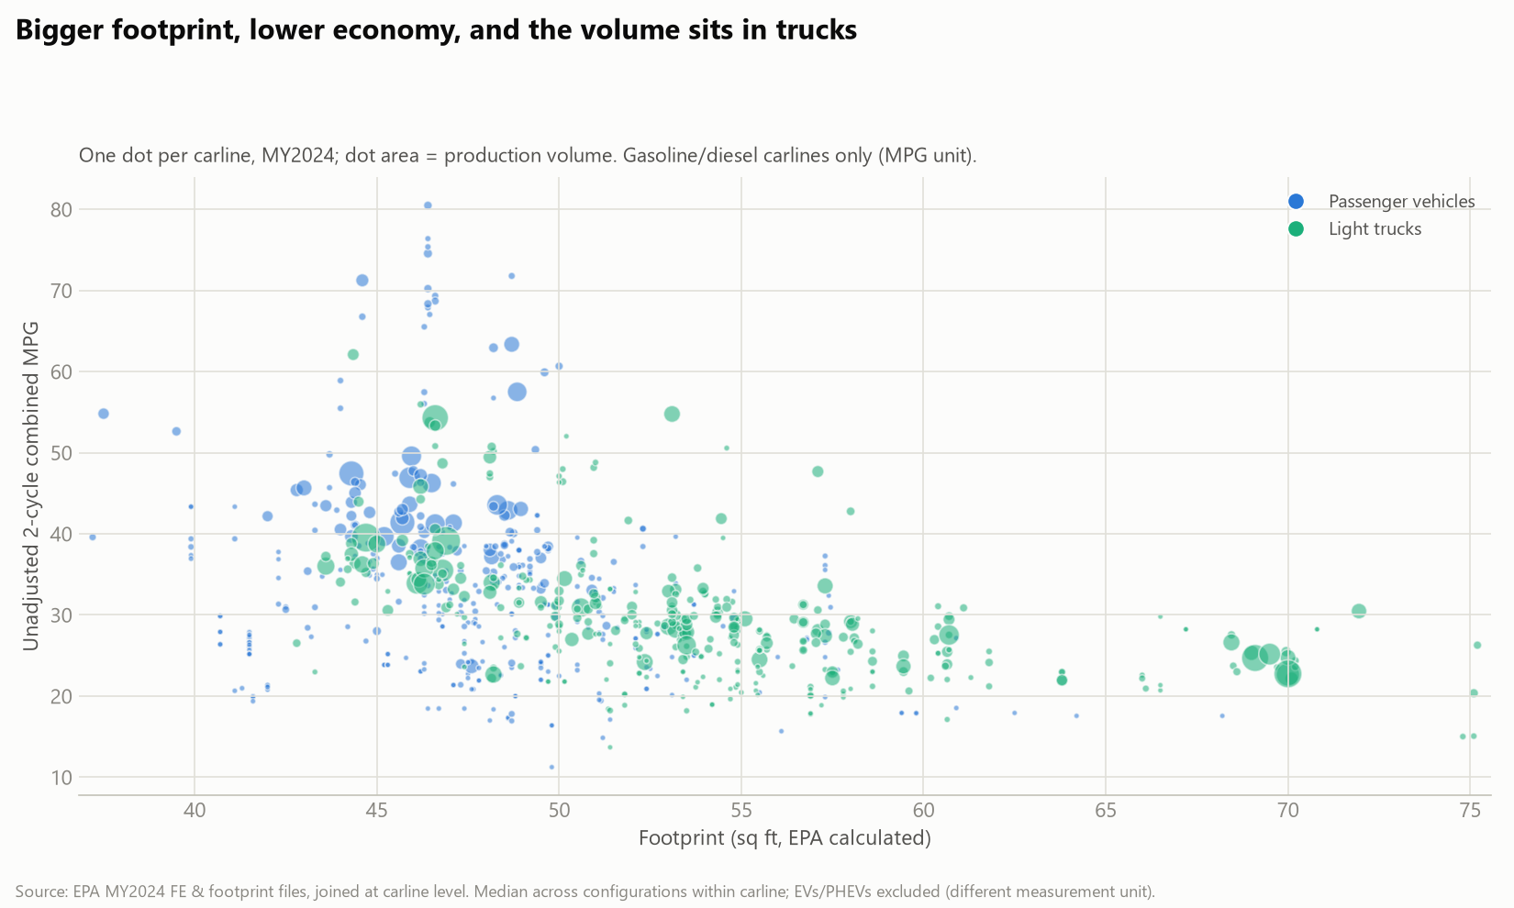
BACKUP Footprint was tested and dropped: size travels with weight
One dot per 2024 carline, footprint against MPG: the raw relationship is visible, but with weight in the equation footprint's coefficient is −0.0001 (t = 0.1, p = 0.87) and the nested F for keeping it is 0.03. Size and mass are the same information to the regression. The combustion-only model (backup table) kept it at p = 0.02 with a tiny coefficient; the pooled model does not need it.
EPA MY2024 FE and footprint files (100% carline join); reports/33_pooled_model.md specs B vs F.
Notes:
Use if asked why footprint, the CAFE standards' own size metric, is not in the equation.

Slide 27
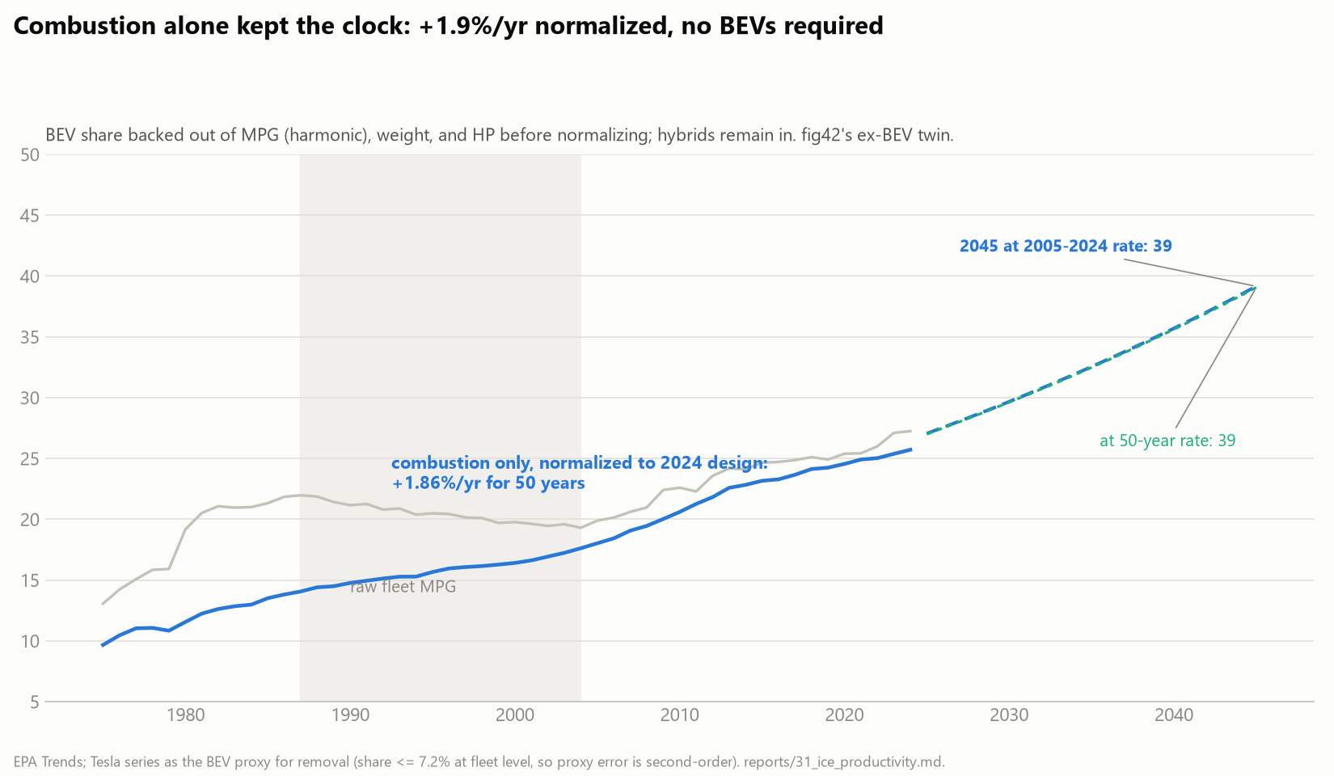
BACKUP Combustion alone kept the same clock: +1.9%/yr with electrics removed
The normalization redone on the combustion-only fleet (electric share backed out, hybrids kept), using the combustion-only elasticities (−0.304 weight, −0.483 HP): +1.86%/yr for fifty years, R² 0.984, projecting 39 MPG by 2045. Electrification is not what makes the productivity line straight.
Stage 31; BEV share backed out harmonically via the Tesla proxy (fleet share ≤ 7.2%); reports/31_ice_productivity.md.
Notes:
Use for 'isn't the productivity line just electrics?' Same clock, no electrics.

Slide 28
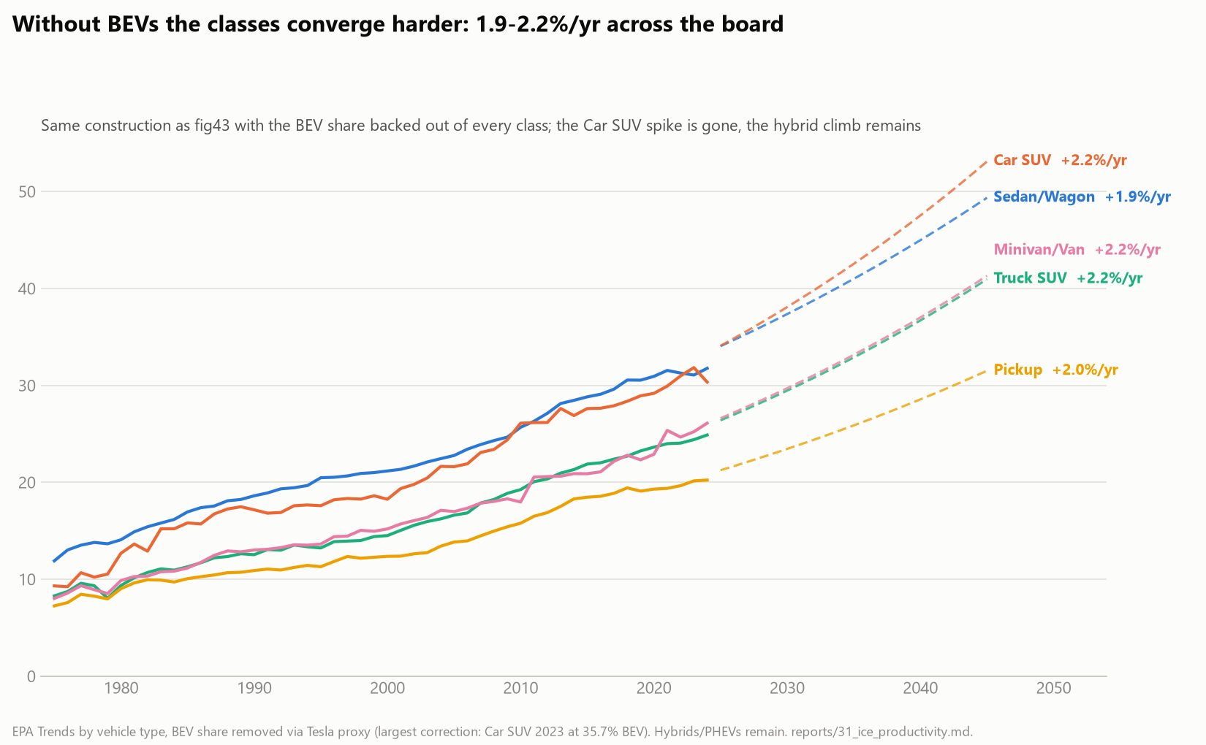
BACKUP The 2023 Car SUV spike was the Model Y, and it vanishes without electrics
In-class BEV share went 0.6% (2019) to 35.7% (2023); remove it and the spike is gone, with classes converging to 1.9–2.2%/yr. The 2024 endpoint wiggle is mix, not missing data: 2024 is final (2025 is the preliminary year, excluded); the sedan dip disappears ex-BEV; the residual Car SUV dip is a lighter, less powerful 2024 combustion fleet.
reports/31_ice_productivity.md incl. the endpoint decomposition.
Notes:
Use for 'what is that spike?' and 'is 2024 incomplete?'

Slide 29
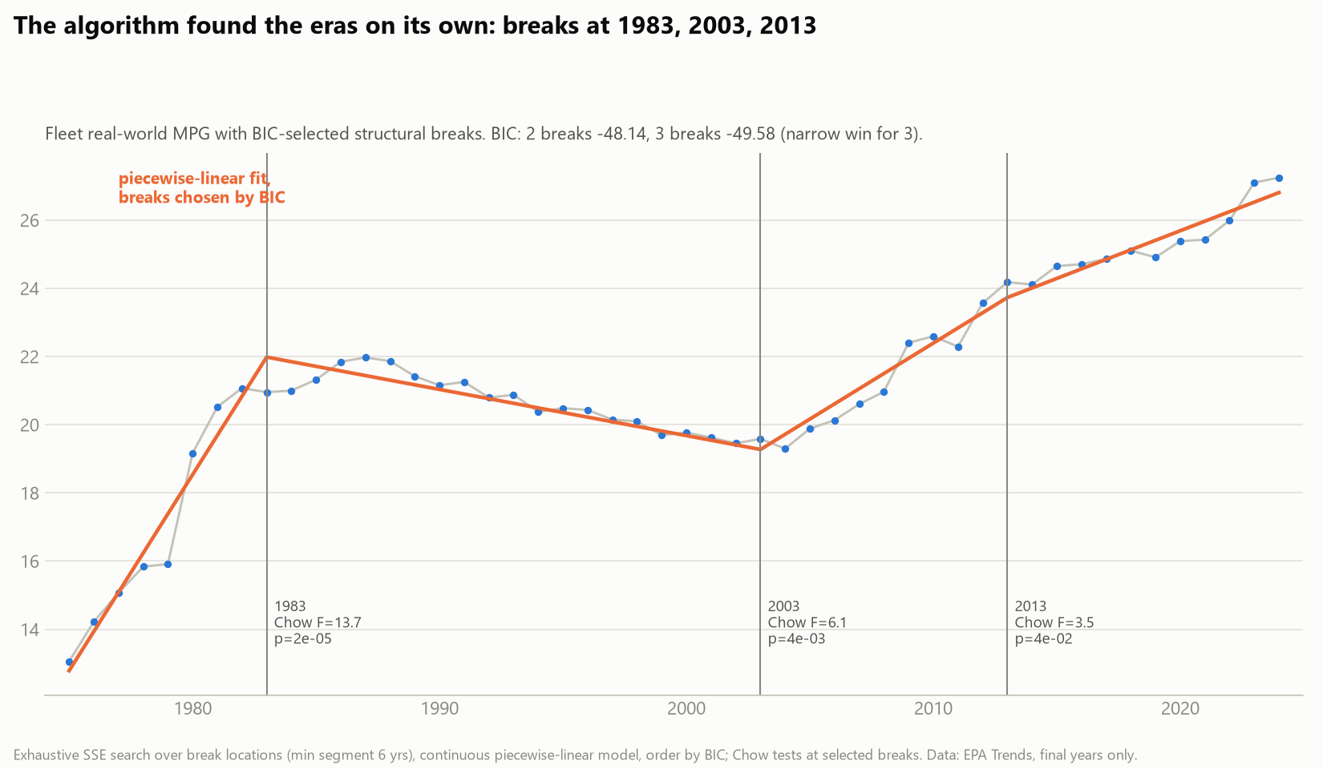
BACKUP The three eras were found by algorithm, not by eye
BIC-selected piecewise-linear breaks in fleet MPG land at 1983, 2003, and 2013, each significant by Chow test (F = 13.7, 6.1, 3.5). The three-act story on the history slide is a model-selection result, not an annotation choice.
Exhaustive SSE search over break locations, order by BIC; reports/10_statistics.md.
Notes:
Use if asked how the eras were chosen.

Slide 30
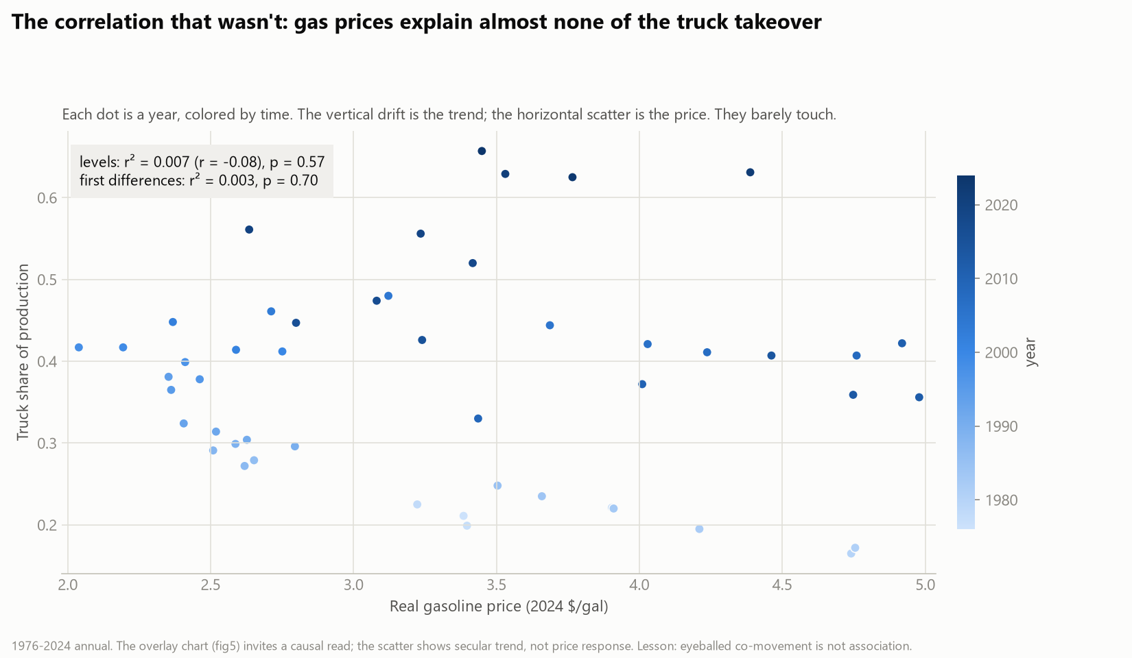
BACKUP We audited our own story: gas prices explain almost none of the mix shift
The overlay everyone believes: cheap gas killed the sedan. The regression: levels r² = 0.007, differenced 0.003. The same audit killed the cheap-credit story (levels 0.57, differenced not significant). One episode survived testing: 1979.
1976–2024 annual; reports/10_statistics.md section 4.
Notes:
Use for causal questions about gas prices or interest rates.

Slide 31
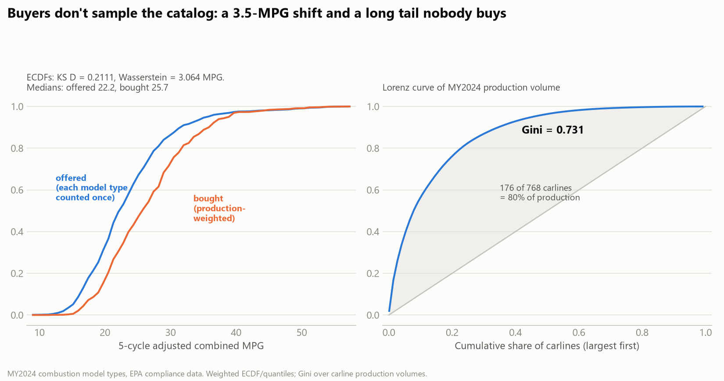
BACKUP Buyers systematically choose better MPG than the catalog median
Offered vs production-weighted MPG, MY2024: KS D = 0.211, a 3.5-MPG median shift toward efficiency, Wasserstein distance 3.06 MPG. Production is concentrated: Gini 0.731; 23% of carlines carry 80% of volume.
MY2024 combustion model types; reports/10_statistics.md section 2.
Notes:
Use for consumer-behavior questions.

Slide 32
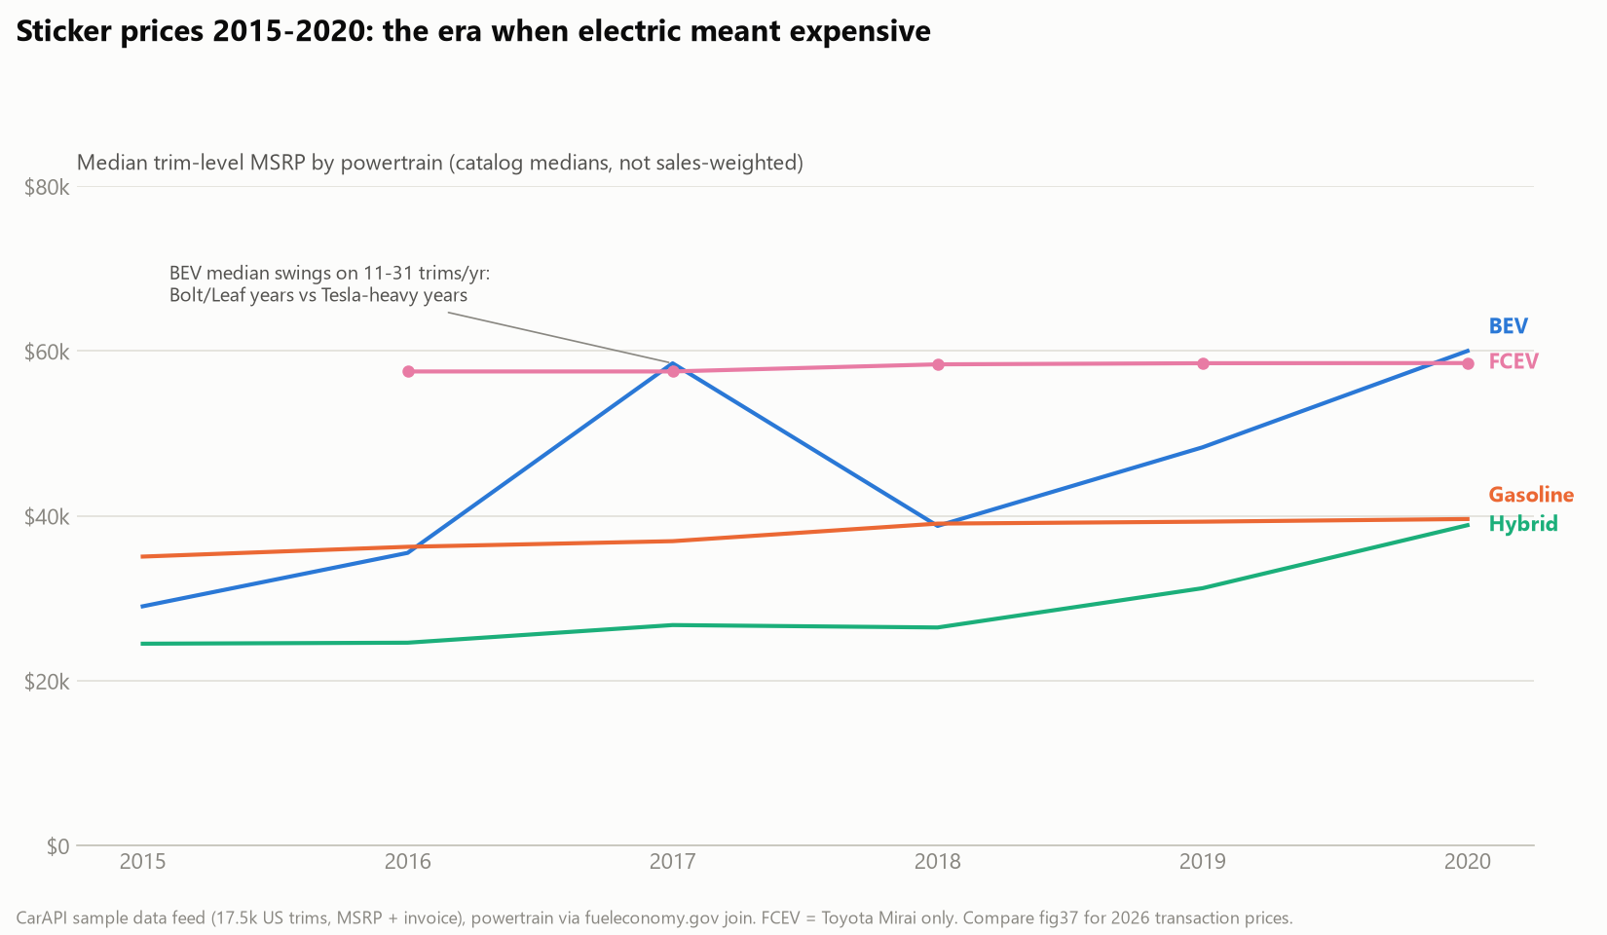
BACKUP Sticker history: the era when electric meant expensive
Trim-level MSRPs 2015–2020 (17.5k trims): hybrids the budget powertrain at $24–39k, gasoline $35–40k, the Mirai parked at $58.5k, BEV medians swinging $29–60k on 11–31 trims a year. By July 2026 the EV transaction premium had compressed to $6,477.
CarAPI sample feed, powertrain via fueleconomy.gov join (80.1%); reports/28_msrp.md.
Notes:
Use for price-history questions; MSRP vs ATP distinction.

Slide 33
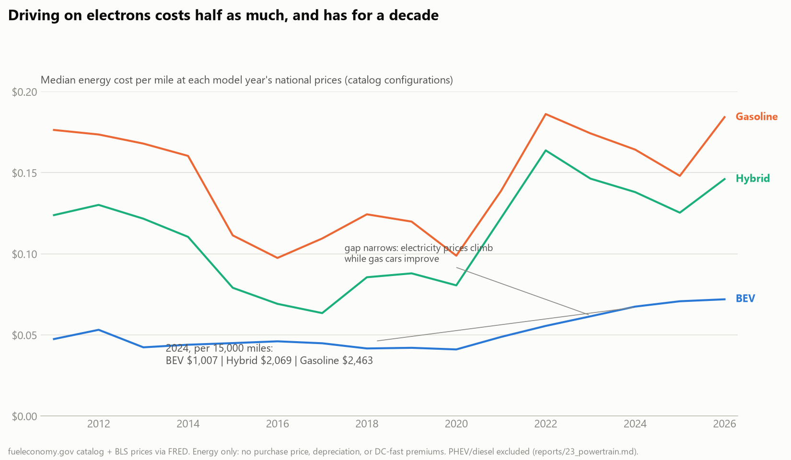
BACKUP Driving on electrons has cost half as much for a decade
Median energy cost per mile at each year's national prices: BEV 5–7 cents, gasoline 10–19. The 2024 gap is $1,007 vs $2,463 per 15,000 miles, and it narrows late as electricity prices climb while gasoline cars improve.
fueleconomy.gov catalog × BLS prices; reports/23_powertrain.md.
Notes:
Use for fuel-cost trend questions; energy only.

Slide 34
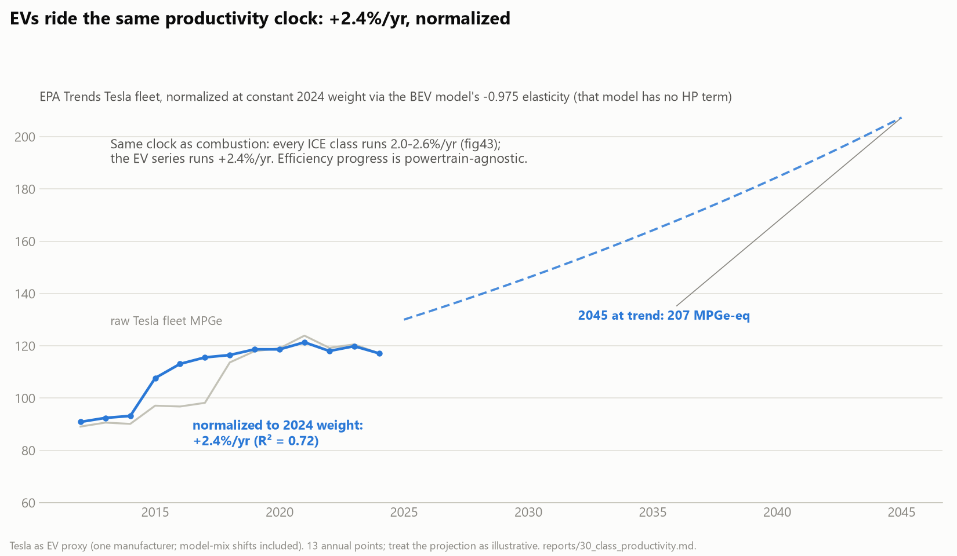
BACKUP Electrics ride the same productivity clock
The only production-weighted EV series with weight (EPA Trends' Tesla rows, 2012–2024), normalized with the BEV-only weight elasticity: +2.36% per year, inside the combustion band. One clock, two energy carriers.
Tesla as proxy, 13 points, model-mix included; reports/30_class_productivity.md.
Notes:
Use for 'do EVs improve faster?'

